Slide 1



DESIGN PROJECT PRESENTATION
OMAR BADER 1201443
EMAN ASFOUR 1200206
MOHAMAD EMAYYA 1202133

Slide 2
LIST OF CONTENTS
Relationship between LDR&PTC with resistance.
Weston bridge & SC circuits of LDR&PTC design.
Ultrasonic sensor detector for water tank level.

Slide 3
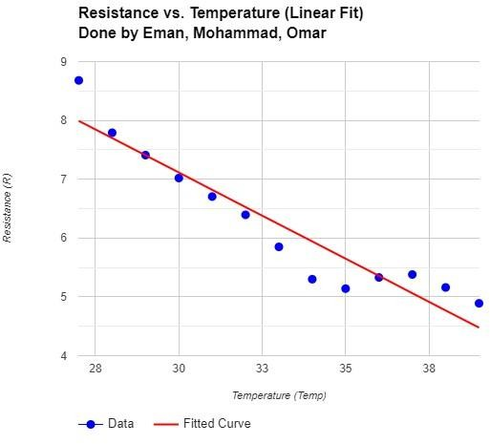
RELATIONSHIP BETWEEN LDR&PTC WITH RESISTANCE
Temperature-Resistance relationship:
the DH11 circuit was built as a reference temperature, and the PTC was heated for different temperatures, and the resistances values was measured.

Slide 4
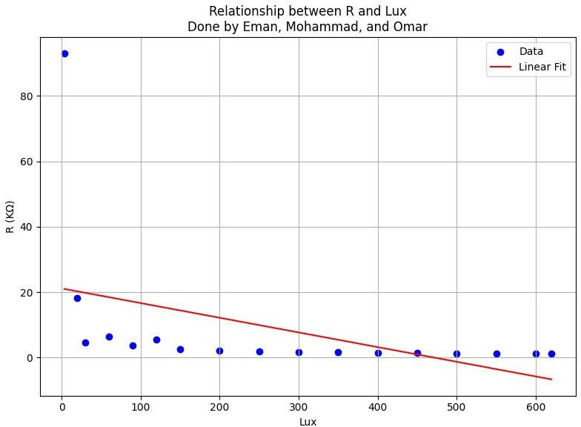
Lux-Resistance relationship:
the Light meter App was used to measure the Lux, and the LDR was exposure to light intensity, and the resistances values was measured.

Slide 5
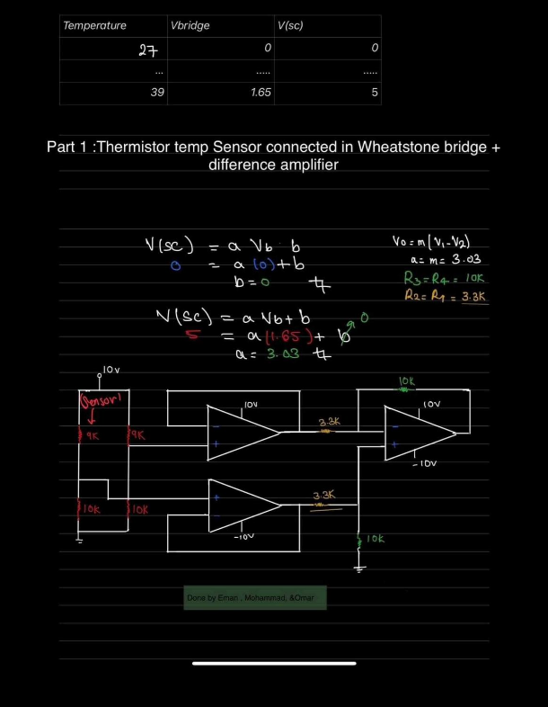
WESTON BRIDGE & SC CIRCUITS OF LDR&PTC DESIGN
PTC design.

Slide 6
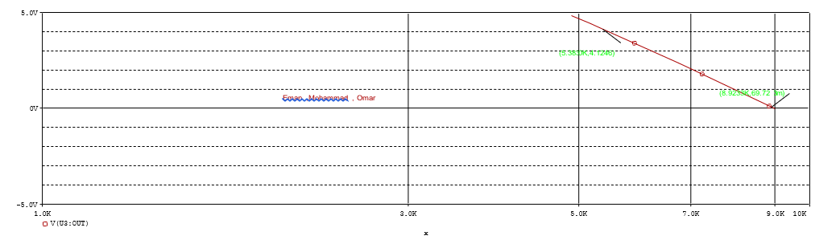
OrCAD implementation results
DC swipe for the sensor resistance between its minimum and maximum values:

Slide 7
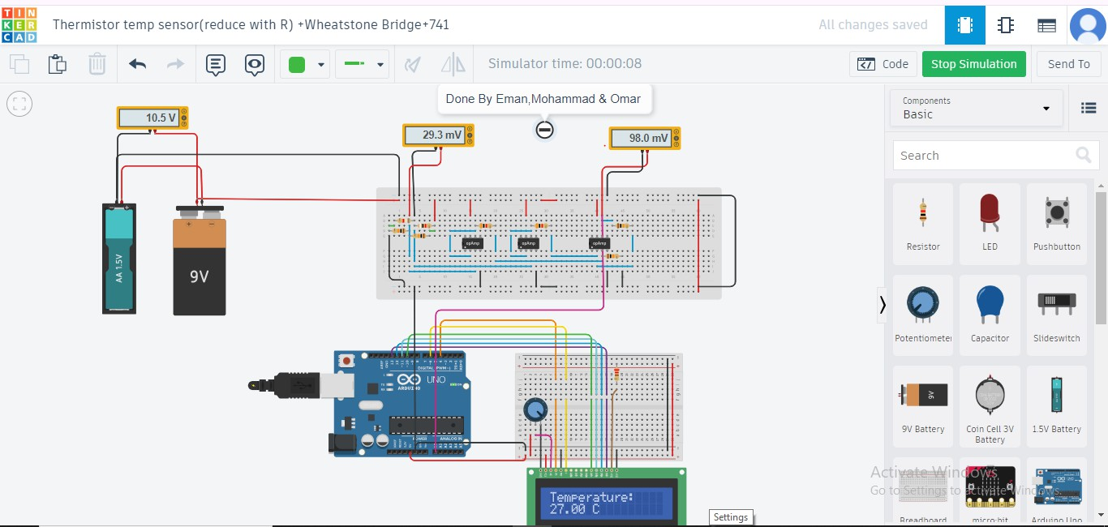
tinker Cade implementation results
When the Weston bridge is balance (Rsensor = 8.9 kΩ):

Slide 8
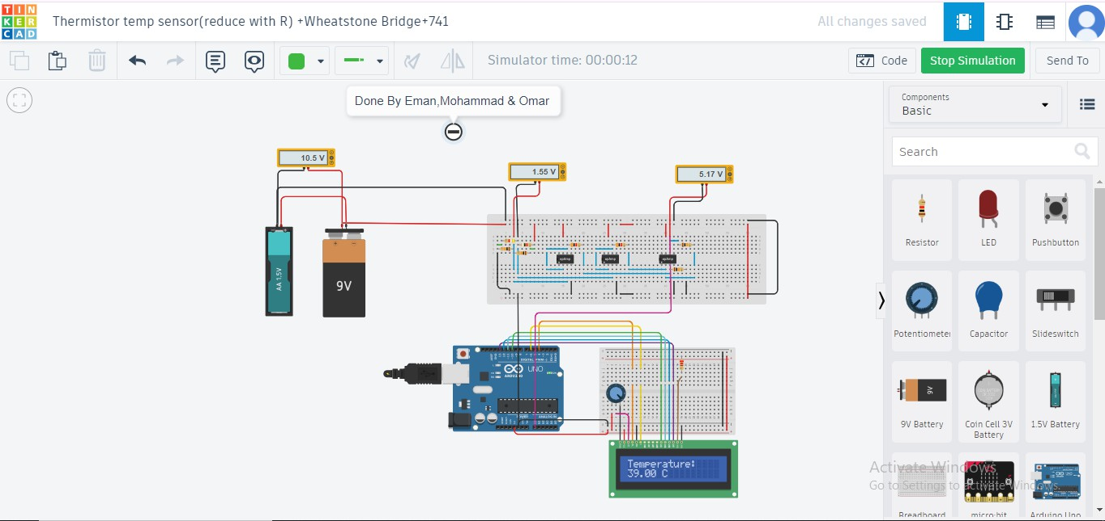
When the (Rsensor = 4.89 kΩ):

Slide 9
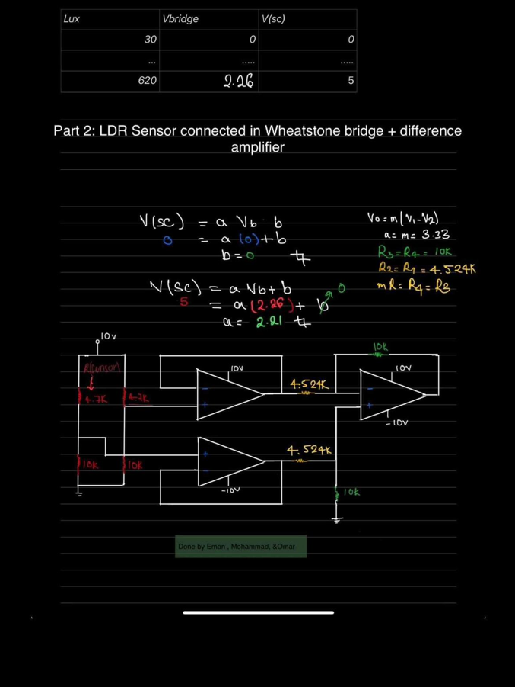
LDR design.

Slide 10
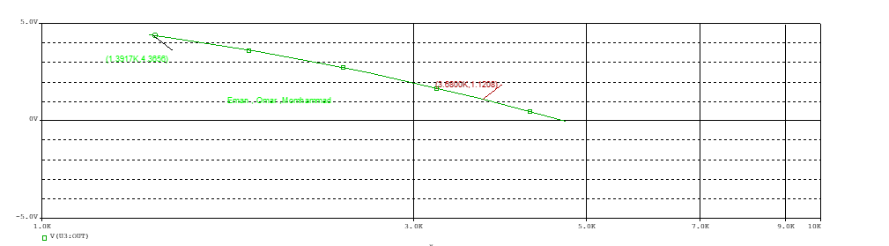
OrCAD implementation results
DC swipe for the sensor resistance between its minimum and maximum values:

Slide 11
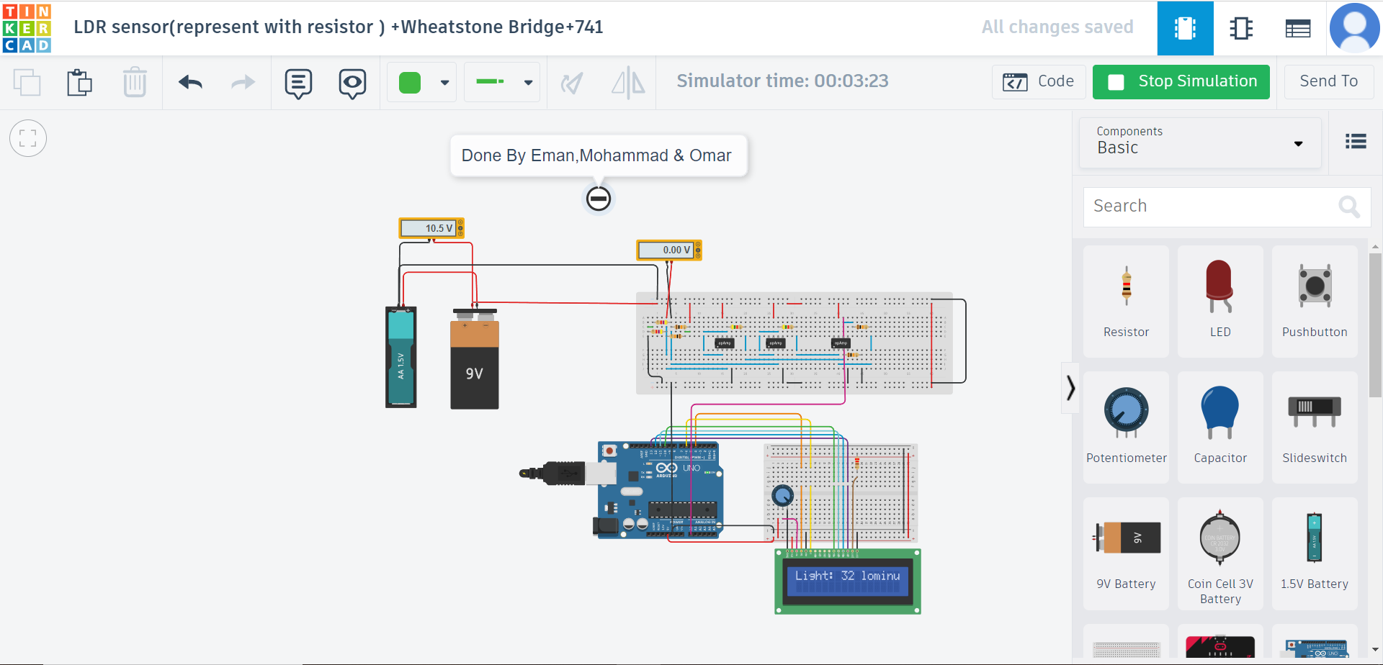
tinker Cade implementation results
When the Weston bridge is balance (Rsensor = 4.7 kΩ):

Slide 12
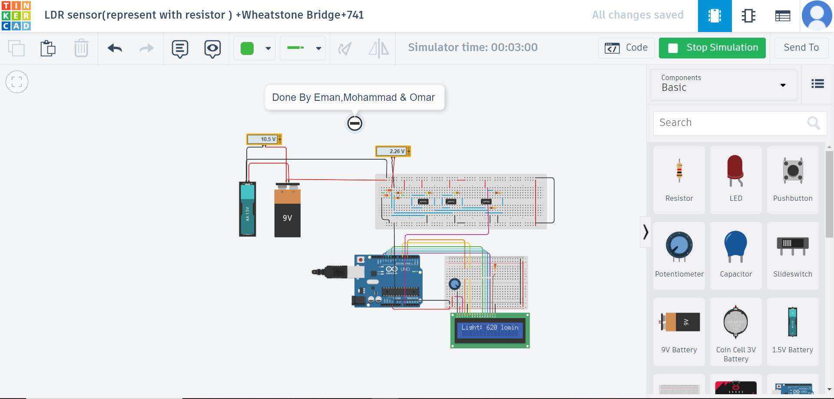
When the (Rsensor = 4.89 kΩ):

Slide 13
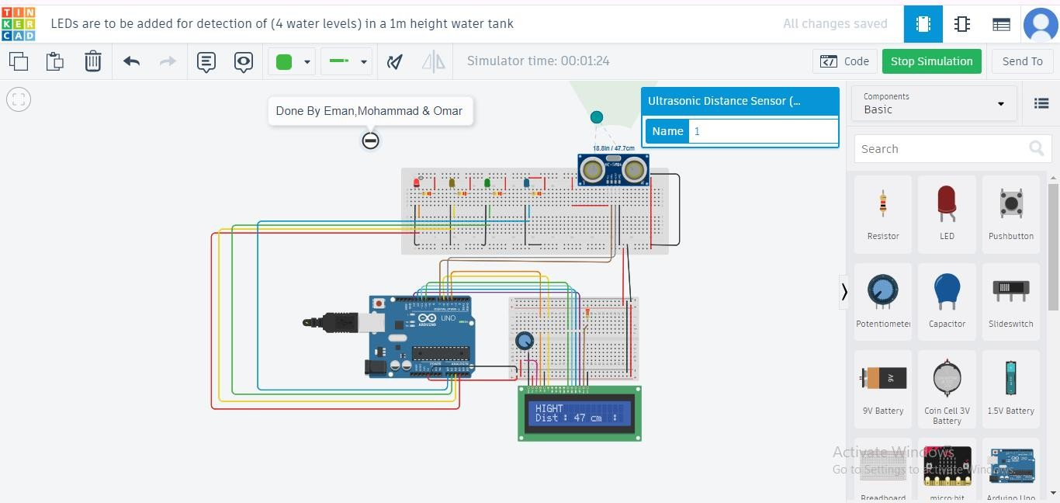
ULTRASONIC SENSOR DETECTOR FOR WATER TANK LEVEL
tinker Cade implementation results
When the Height 50cm:

Slide 14
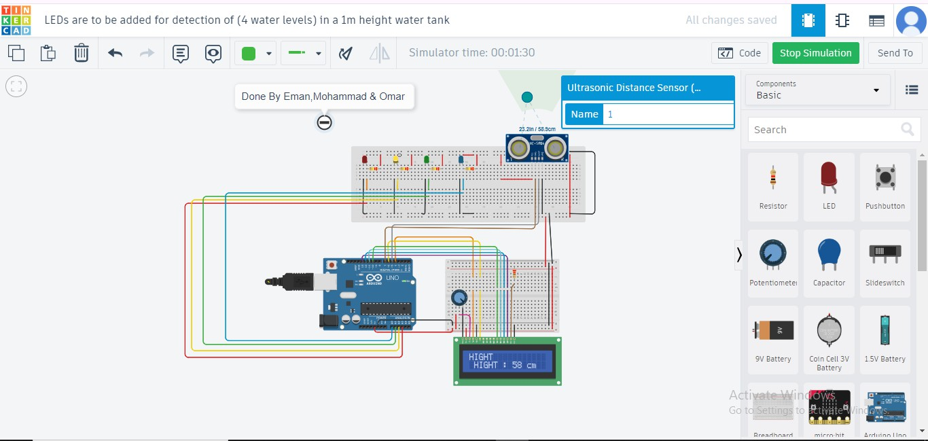
When the Height 70cm:

Slide 15
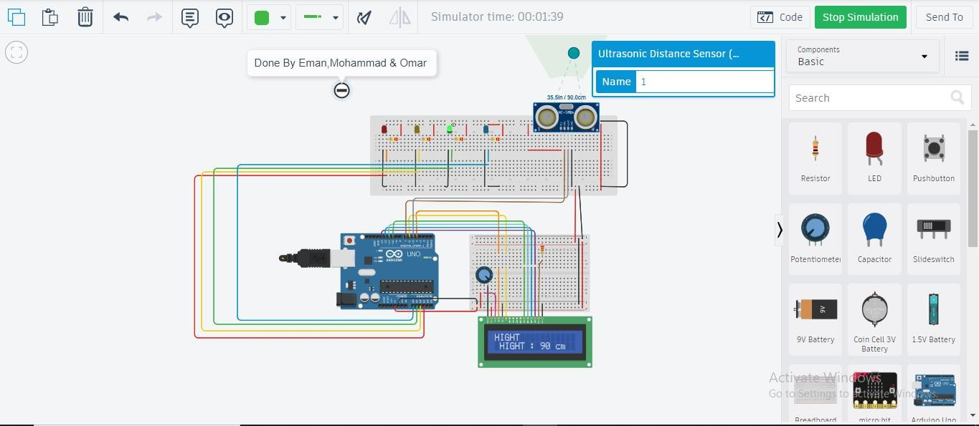
When the Height 90cm:

Slide 16
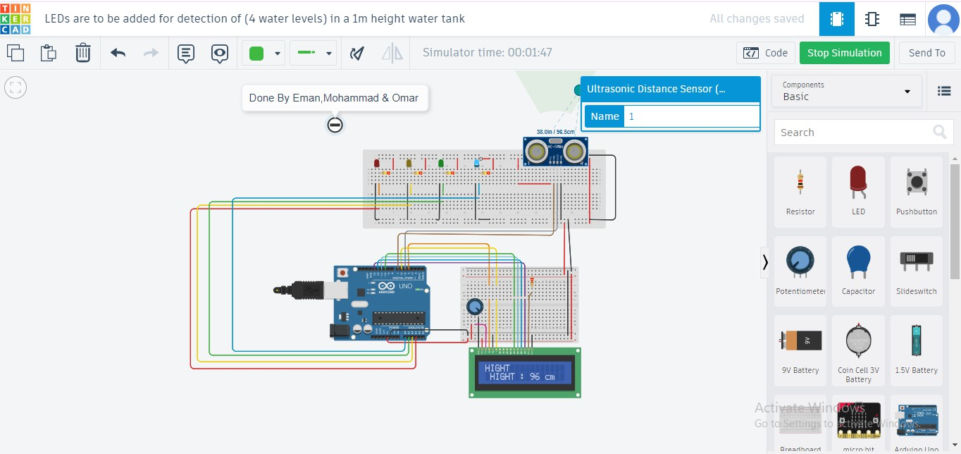
When the Height 100cm:

Slide 17
THANK YOU

